Slide 1



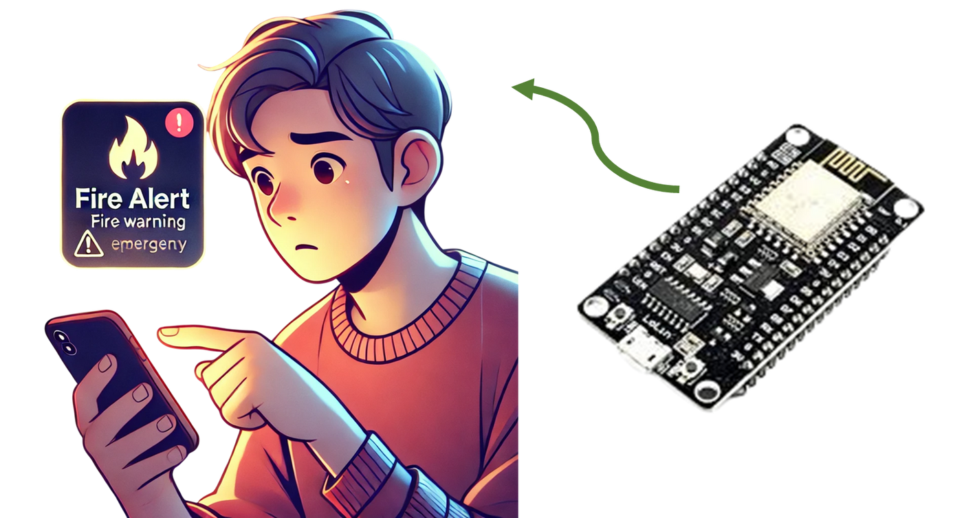
IOT BASED FIRE DETECTION USING ESP8266
Designed by : - RITIKA SHARMA
Registration No.: - 10423210004
Course: - B.TECH(ECE)
Course Year: - 2nd Year, 4th Semester(2024 - 2025)
Batch: - 2023-2027

Slide 2
CONTENTS
Project overview
Components Used
Component Description
Circuit Description
Information Flow
Code Used
PCB Design and Development Process

Slide 3
PROJECT OVERVIEW
In this project we use ESP8266 microcontroller, and integrate it with SMTP server for email service and an IoT based cloud service named ThingSpeak which displays real time data to user.
We will use Flame Sensor to detect the presence of flames and MQ02 sensor to detect the presence of smoke.
The data received by the sensors will be sent to the microcontroller ESP8266 which will read the code fed to it and will determine if a fire has started or not.
If the controller decides that there is a fire, it will send commands to the SMTP server to alert the end user by sending them push notifications, SMS and email.

Slide 4
COMPONENTS USED
Hardware
Softwares
NODEMCU ESP8266 Module
Flame Sensor
MQ 02 Smoke Sensor
Arduino IDE (SMTP Server included here)
ThingSpeak
Eagle CAD
Extra Materials
Berge Connectors
PCB Board(Self Made)

Slide 5
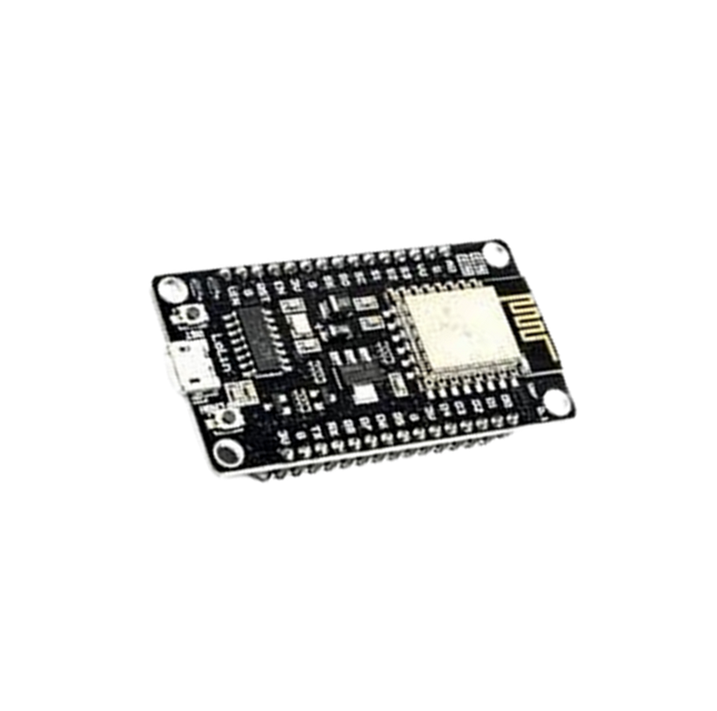
COMPONENT DESCRIPTION
NodeMCU ESP8266 WiFi Module
Why use this instead of Arduino Board?
Arduino board in itself does not contain a WiFi Module. We have to use an external WiFi module like ESP01 but that would just increase the circuit area.
ESP8266 , however is a microcontroller just like Arduino but has a inbuilt WiFi module that supports Arduino IDE, hence we will be programming it in it the same way Arduino would be programmed.
Small Description
Operating Voltage : 3.3V
It supports TCP/IP networking, can be programmed using Arduino IDE, and features GPIO, PWM, and ADC functionalities.
Useful for IoT based, home automation systems, like this project.

Slide 6
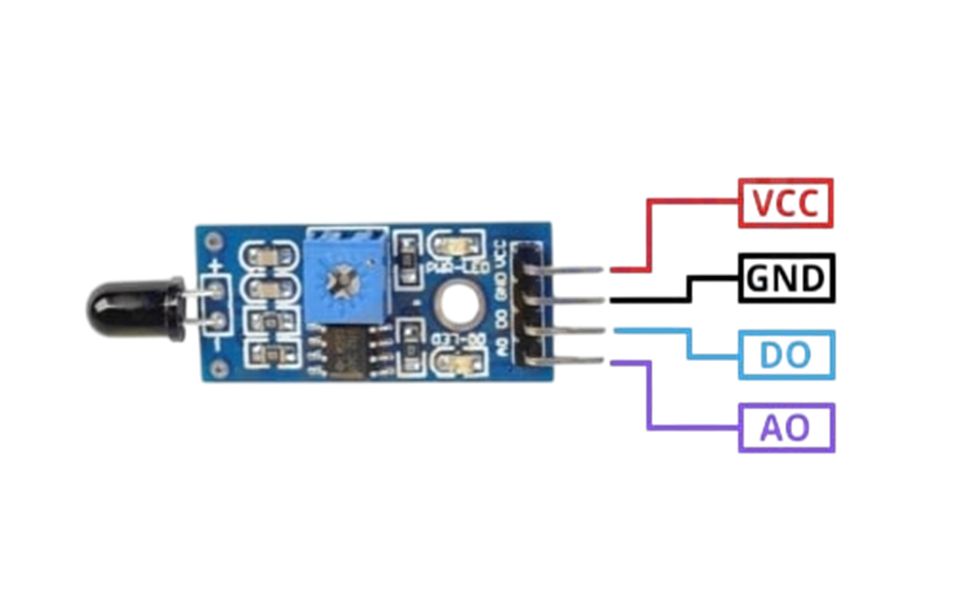
COMPONENT DESCRIPTION
Flame Sensor
Why use this?
This device is used to detect the presence of a flame.
Small Description
Operating Voltage : 5V
It uses a comparator to give output as “LOW’ (At the DIGITAL PIN) when fire is detected.
It has an IR sensor that detects the fire.

Slide 7
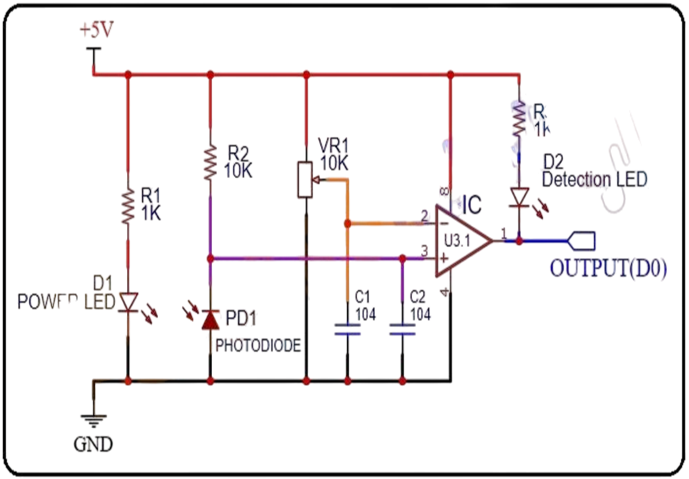
COMPONENT DESCRIPTION

Slide 8
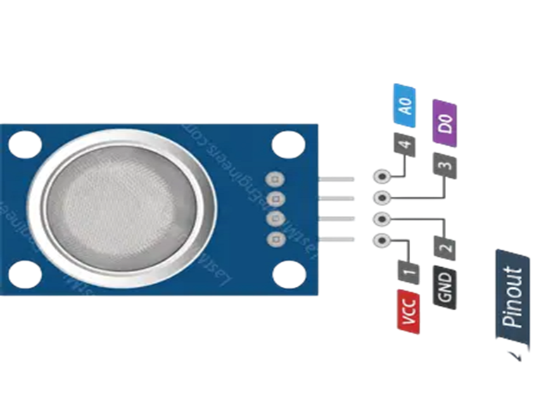
COMPONENT DESCRIPTION
MQ02 Sensor(Smoke)
Why use this?
This device is used to detect the presence of smoke.
Small Description
Operating Voltage : 5V
We will be using it’s “ANALOG OUT” PIN to check the amount of smoke that it detects whose intensity is represented by the computer as numbers ranging from 0 to 1023(10 bit sensor).

Slide 9
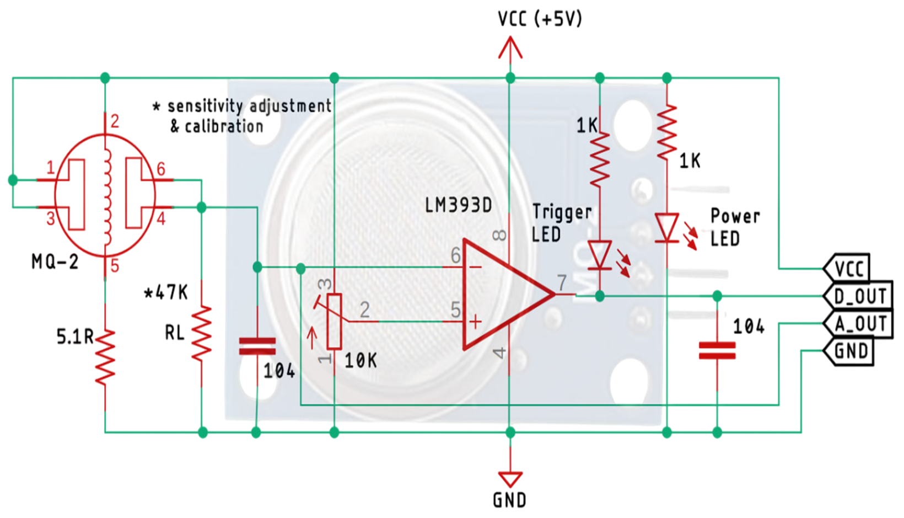
COMPONENT DESCRIPTION

Slide 10
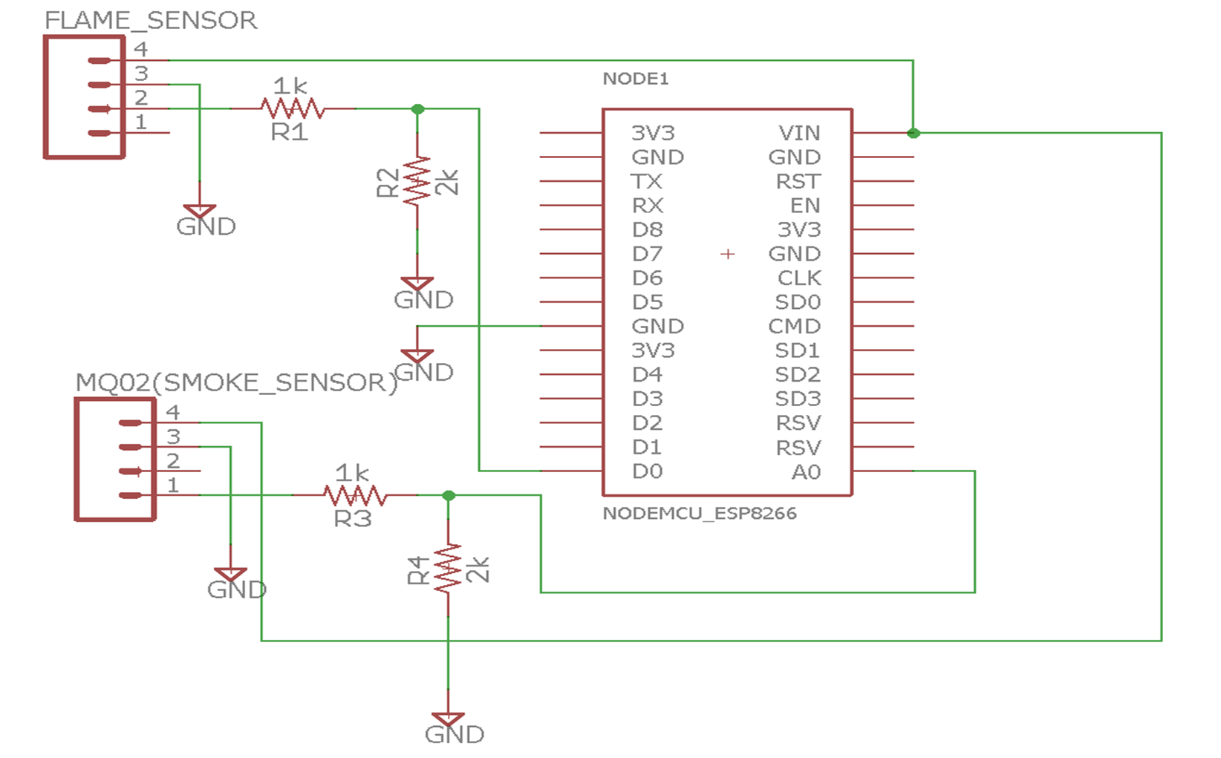
CIRCUITRY IMPLEMENTED IN PROJECT

Slide 11
CIRCUITRY IMPLEMENTED IN PROJECT
Circuit Working
1.We are only using the “DIGITAL OUT” PIN of the Flame sensor. Whenever it detects a flame, it goes “LOW”.
2. We are only using the “ANALOG OUT” PIN of the MQ02 sensor. It’s value changes from 0 to 1023(10 bit sensor).
3. This output is fed to the series system of 1k and 2k resistors from both sensors.
4. By the potential divider concept, the voltage drop that appears at 2k resistor due to the flame sensor is fed to D0 pin of the ESP8266 board.

Slide 12
CIRCUITRY IMPLEMENTED IN PROJECT
Circuit Working
5. By the same concept, the voltage drop that appears at 2k resistor due to the MQ02 sensor, is fed to A0 pin of the ESP8266 board by the flame sensor.
6. The work of the sensors and circuit ends here. Rest work is done by ESP8266, SMTP Server and ThingSpeak Cloud.

Slide 13
CIRCUITRY IMPLEMENTED IN PROJECT
Why use a Potential Divider Circuit?
1.The ESP8266 unlike Arduino boards, only support 3.3V(+/-0.1). Feeding it any more than this would harm the controller.
2. However, as we learned in the “Component Description” slides, both the sensors work at 5V.
3. Hence they would give the following outputs:
Flame sensor(D0): 0V(LOW) or 5V(HIGH)
MQ02 sensor(A0): 0 to 5V
4. This is not suitable to the circuit. Hence, to avoid this problem, we use a potential divider circuit.

Slide 14
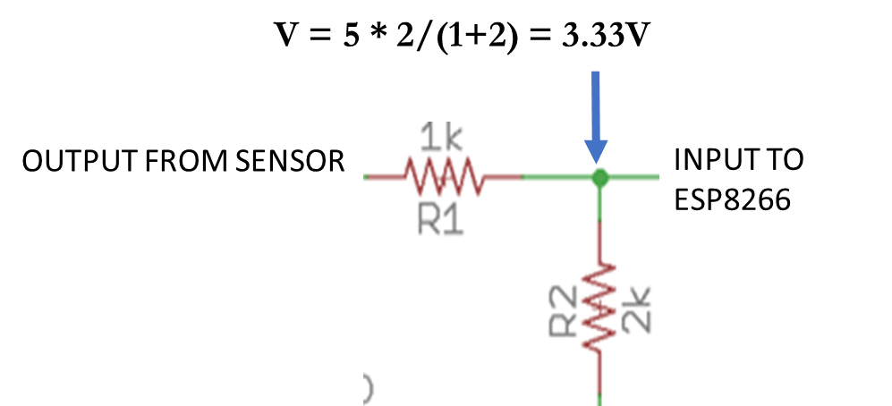
CIRCUITRY IMPLEMENTED IN PROJECT
Why use a Potential Divider Circuit?
According to this diagram, the value of V = 3.33V which is safe operating voltage of the controller.
Now we can use our controller and sensors normally.

Slide 15


INFORMATION FLOW
Flame + Smoke detected by sensors
Microcontroller makes a decision : fire detected
Sends data to SMTP SERVER and THINGSPEAK
Data fed to ESP8266
SMTP sends email alerts to end users.
ThingSpeak displays real time data to user.
User Alerted!!

Slide 16
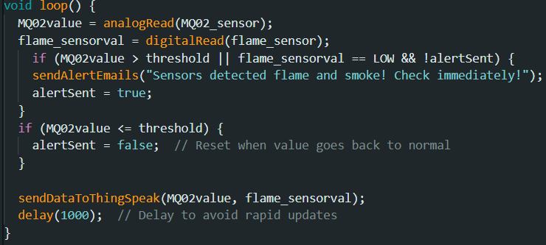

ARDUINO CODE
Here are some snippets of the code used:

Slide 17
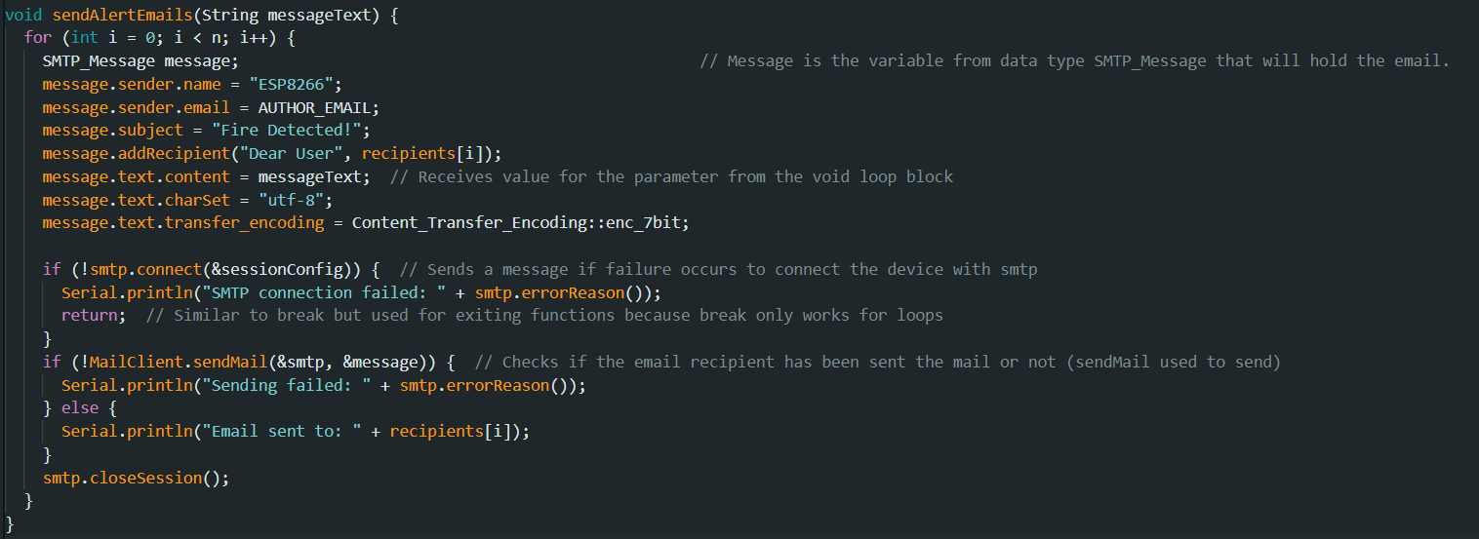
ARDUINO CODE
Here are some snippets of the code used:

Slide 18
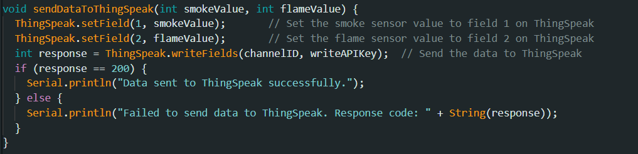
ARDUINO CODE
Here are some snippets of the code used:

Slide 19

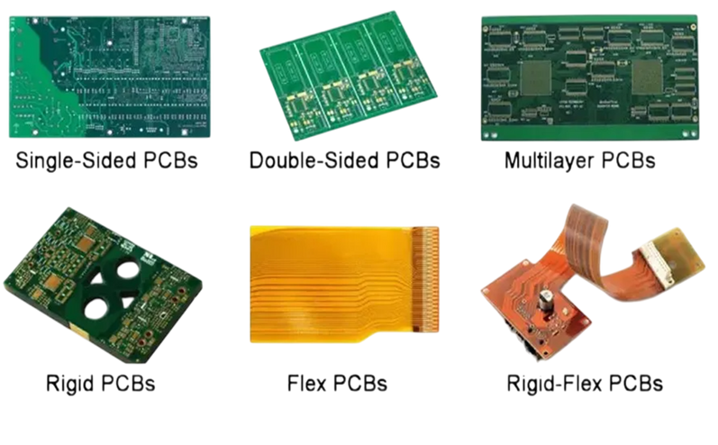
PCB MANUFACTURING PROCESS
Step - 1 : Copper Clad Boards
It is made by using a fibre or glass of suitable height and width with a layer of copper on top to provide conduction.
This is the base for our PCB(Printed Circuit Board).
Step - 2 : Type of PCB
There are a number of types of PCBs, single sided, both sided, etc.
Here, because of the simplicity of our circuit, we will be making a single(bottom sided) PCB.

Slide 20
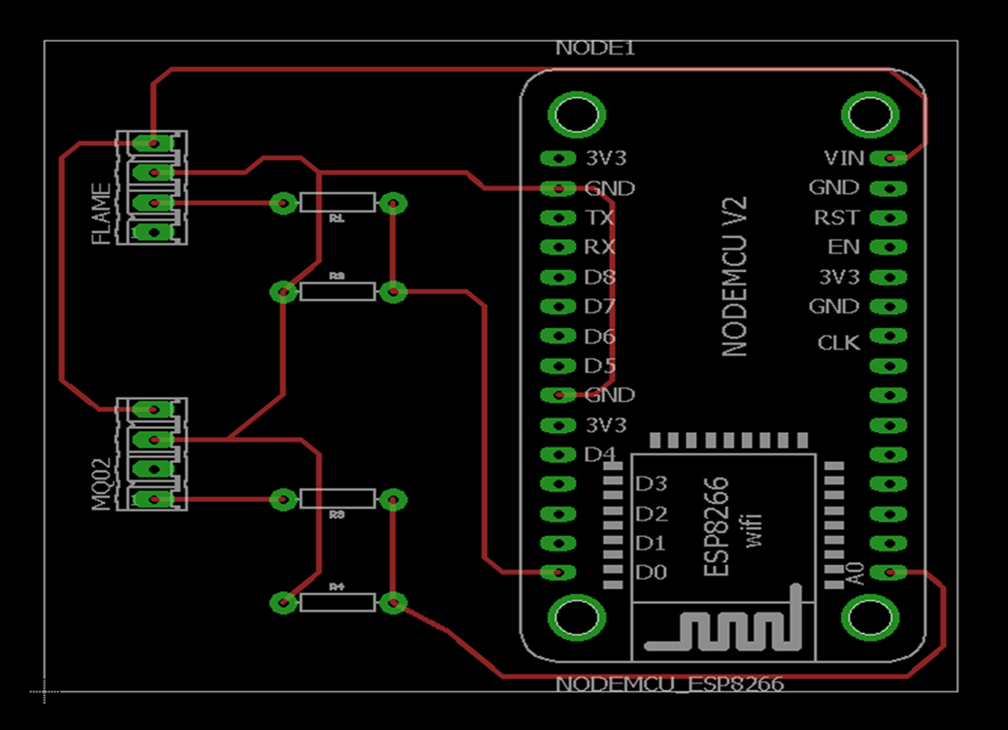
PCB MANUFACTURING PROCESS
Step - 3 : Designing Schematic
We do this by using a PCB designing tool called EAGLE CAD.
This is how the designed schematic looks.

Slide 21
PCB MANUFACTURING PROCESS
Step - 4 : Printing PCB design
We use a laser printer to print out the previous design on Photo paper.
Step - 5 : Hotpressing design on board
We use a cloth iron to press this design on the copper side to transfer the printed track onto it.
Step - 6 : Removing rest of copper
We only want the tracks that are marked as red colour in the design.
To remove the rest of the portion, we dip this board in a solution of FeCl3.
This removes all other copper except those that is beneath the layer of printer ink.

Slide 22
PCB MANUFACTURING PROCESS
Step - 7 : Drill holes in place of pads to add components.
Step - 8 : Remove ink by using petrol.

Slide 23
CONCLUSION
We designed a project that used basic electronic components to record real world data and learnt how to integrate this data with the internet to perform tasks like sending emails, SMSs, displaying real time data using gauges, etc.
Upgrades that can be done in project
Send alerts using SMSs or push notifications as they are faster.
Develop an app or website where user can monitor real time data with ease.
Use a charging module and battery for power supply instead of USB based direct supply using laptop.

Slide 24
Thank You!
Any queries or questions are welcomed

